Slide 1
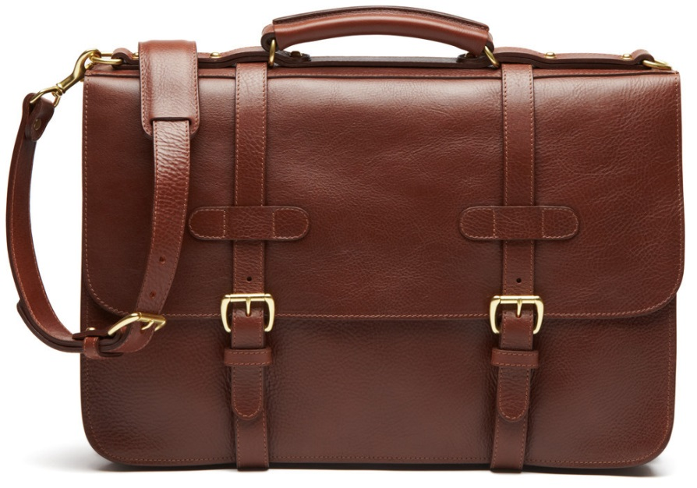
Dressing for Success
Student Career Development
Administration 036
Careers@shawnee.edu
(740) 351-3027
Notes:
When it comes to dressing for success, you’d better look the part or you might not get the part at all. Because people definitely do judge a book by its cover, especially in business
Kevin O’Leary (entrepreneur, Shark Tank), “You have to dress as your clients expect to see you, to their expectations,”

Slide 2
Why is this important?
You never get a 2nd chance to make a 1st impression!
55 % of another person’s perception of you is based on how you look.
“75% of recruiters believe that how a person dresses for work affects one's job, salary, and possible promotions”
(http://wingsforsuccess.org)
“Your first impression is always a lasting impression”

Slide 3
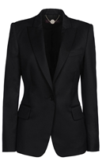
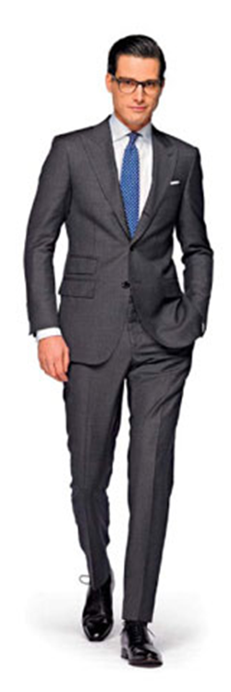
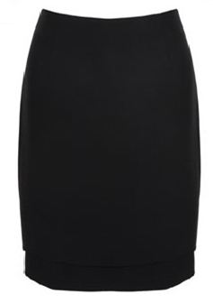
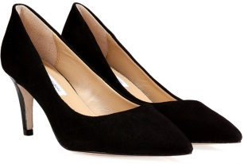
The Basics
Dress for the job you want, not the job you have.
Stick to neutral, solid colors
Accessorize to dress up different pieces
Stay professional
Wear something you feel good in!
Try setting aside outfits for the week
Double Down
Notes:
Wearing loud colors may make the interviewer infer things about (~credibility) you or distract them from what you are saying.
ALSO, nothing with WORDS on it
- black, blues, greys, beige, and light purples are best
STAY PROFESSIONAL:
If you would feel comfortable meeting your friends for drinks after, you’re not appropriately dressed – you should look boring!
Make sure it covers your skin (~bending over)
COMFORT:
Your interviewer will be able to tell you’re uncomfortable if your constantly adjusting your clothing or shifting a lot
Double Down
There are some things that are worth investing in, if you are able. Shoes, handbags and outerwear are top of the list. Why? Because they complete the look. Pair an awesome pair of shoes with less expensive apparel and the look is instantly elevated. Same goes for handbag or outerwear.

Slide 4
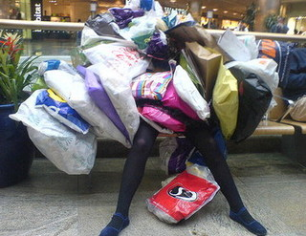
When Buying New Items
Quality over Quantity
First, what items do you already have in your wardrobe?
Ask for items as gifts
Shop sales!
Browse consignment and thrift stores
Let others know you are revitalizing your wardrobe
Think about material before buying (will it need to be dry cleaned?)
Notes:
ITEMS YOU ALREADY HAVE:
Look in your closet and see what items you already have before going shopping & this will save you money. For example, if you already have a nice pair of pants, only shop for a matching belt or blazor.
ASK FOR ITEMS AS GIFTS:
For your birthday or Christmas, maybe pick out one expensive item, such as nice shoes or a fitted blazer, rather than receiving/asking for several small items
LET OTHERS KNOW..:
If you let friends and family know, they may have sale/store ideas for you, send you coupons, or even hand down some nice items.

Slide 5
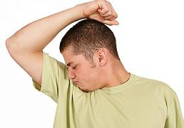
Hygiene
Body Odor
Take a shower!
Wear deodorant
Minimal perfume/cologne
Breath
Well-brushed and fresh breath
Don’t eat foods that will leave an odor
Do not chew gum or eat mints during an interview!
Notes:
TAKE A SHOWER:
If you haven’t showered, they will want to get you out as soon as possible and will not even give you a chance.
DON’T EAT FOODS…:
Beware of COFFEE BREATH, don’t smoke or drink alcohol beforehand

Slide 6
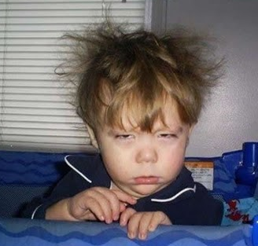
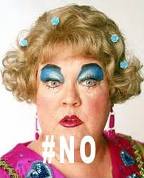
Appearance
Hair
Well-groomed
Don’t use too much product
Men – Get a hair cut 3-5 days before (if needed)
Make-up
Minimal/natural
Facial Hair
Neatly trimmed
Remove piercings
Fingernails
Cleaned and trimmed (1/4 inch past finger tips)
Ladies - Clear polish
Clothing
Clean and ironed
** Arrive early and check your appearance
Notes:
You know.. Look like you want to be there

Slide 7
Men
Make sure your suit is tailored
Button only one or two buttons
Wear a long-sleeved shirt
A briefcase makes a great accessory!
Wear a tie with “classic” colors
Your shoes, belt, and socks should match
Jewelry should be limited
Notes:
SUIT:
“It’s not about having money,” he said. “If you have a suit that only cost $150, go the extra mile and get it tailored. Shine your shoes. Make sure you manicure your nails. It’s the simple things that people notice, that take you far.”
BUTTON:
Button the middle button or top two buttons ONLY
A BRIEFCASE MAKES..:
Ask for a briefcase as a gift, or borrow a nice one from someone for your interview
TIES
maroon, blues
- Learn how to tie a tie!!
SHOES, BELT & SOCKS:
Belts should be about 1 in width, and NO large belt buckles
Make sure your SHOES are polished/look nice
JEWELRY – one ring and watch is acceptable

Slide 8
Women
Suit
Conservative dark black, navy, dark gray, brown or tan wool-blend suit
Skirt length should be a little below the knee
Business dress with matching jacket is okay
Blouse
Tank-top style or tailored shirt—should be cotton or silk and should be white, or some other light color
Pantyhose?
Always—it should be the color of your skin and flawless
Purse or briefcase?
Opt for a briefcase or just a leather pad-folio
It should be the same color as your shoes
Shoes
Low heels, 2 inches or less—no spike heels.
Notes:
Suit - pants / skirts: Tailored pants suits are appropriate for women. Pants suits can be an excellent
choice for site visits, particularly if the visit involves getting in and out of vehicles and/or the site is (or
includes) a manufacturing plant or industrial facility. If you wear pants, they should be creased and
tailored, not tight or flowing.
- If you are pursuing a conservative industry and are in doubt, observe well
dressed women in your industry on the job, at career fairs, at information sessions, etc.
No one will want to take you seriously if you are wearing a short skirt
NO party, cocktail or sun dresses.

Slide 9
Types of dress
“Business Professional”
“Business Ready”
“Business Casual”
“Casual casual”

Slide 10
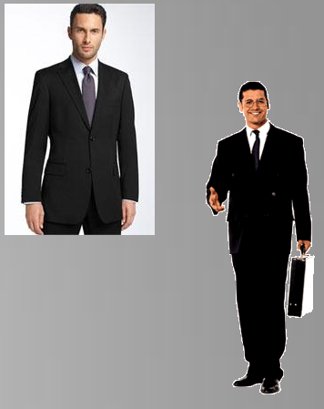
Business Professional
Notes:
The goal for business professional is to look the best you can • You may be meeting new clients or representing your firm at an event • The way you dress represents you and your company Rule of thumb: If you have to question an item, don’t wear it.

Slide 11
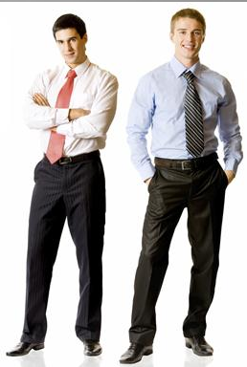
Business Ready
Notes:
“Business Ready” is defined by being one simple change away from business professional – Taking over as the new “Business Casual” • By keeping a neutral colored jacket and a pair of polished shoes in your office you can be “Business Professional” in minutes

Slide 12
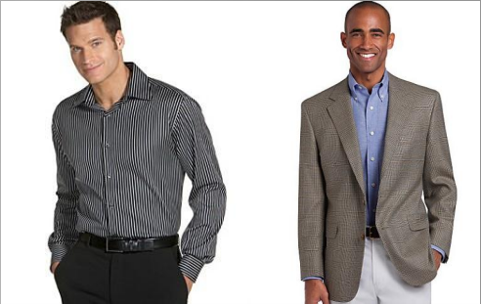
Business Casual
Notes:
Very hard to define, each office has a different point of view – Ask your co-workers • Ranges from not wearing a jacket, to wearing jeans and sandals Our advice: Keep it neutral, keep it covered, keep it classy
You don’t want to be too casual, but you also don’t want to be too dressy – If you show up to work in a full three piece suit on a casual day people will have their opinions about your dress as well • Most important thing: Know what is appropriate – If you don’t know ask! • Most businesses will have their clothing guidelines outlined in the employee handbook

Slide 13
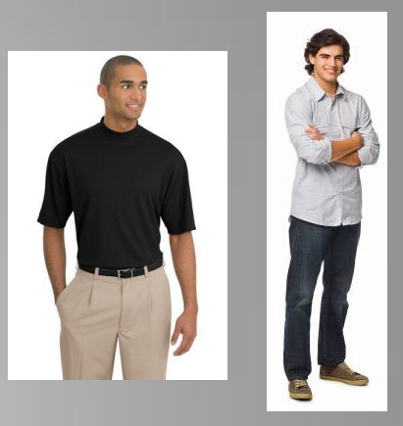
Casual Casual
Notes:
Think of what to wear at a company picnic • Includes: Jeans, casual pants, t-shirts, tennis shoes • DOES NOT include: – Short shorts, spaghetti strap tank tops, tube tops, or shirts with profanity or graphics Know what is appropriate!

Slide 14
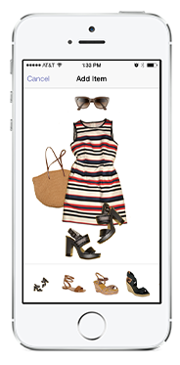
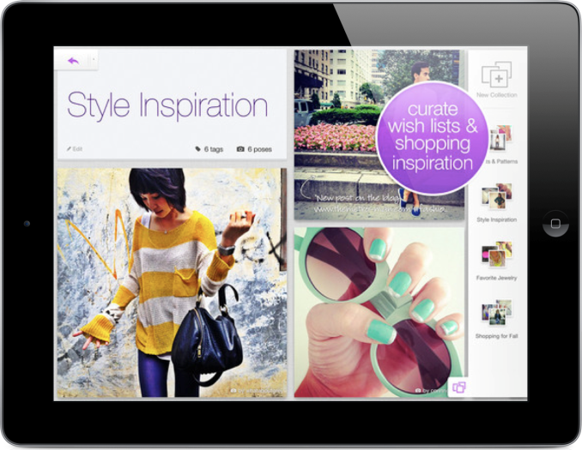
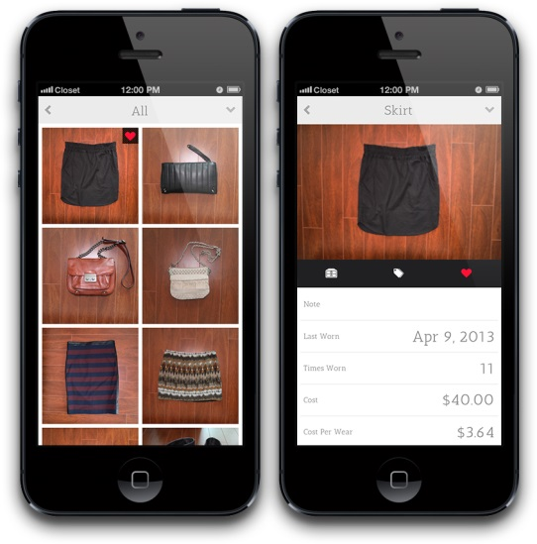
Extra Tips
Have a “toolkit” handy
Use an app to help you match and organize your wardrobe!
Stylebook, Pose, Closet, Stitch Fix
If you are struggling with what to wear – ask someone that you feel has good fashion sense.
Notes:
Stylebook also has an app specifically for men
On Pose, you can get other’s input on outfits or shopping ideas (if you’re indecisive like me, esp. with large purchases)
THE TOOLKIT IS KEY:
If you are traveling for an interview or business trip, or even things to just have handy at your desk on the job: Invest in a hand-steamer over an iron. It’s compact, quick and so much easier than the alternative! Keep it in your bathroom for last minute touch ups. Other tools to keep handy at your desk or in your bag include a lint brush (or masking tape in a pinch) and polishing cloths for shoes and jewelry.

Slide 15
SSU Bear Share
Stop by Student Career Development to take advantage of free donated business attire!
It will be especially popular during our job fair registration so stop by early!

Slide 16
Quiz
Complete this online quiz by clicking on the link & answering the questions
There will be weeks during the semester where we send emails about a drawing for having the quiz completed by a certain date
https://forms.office.com/Pages/ResponsePage.aspx?id=IFyHJnWyD0WMgACyQ421GztZCWXX7PRKk4oe8BUmKAJUNDZHM1ROQ0Y5R0NaWjhTVUJLNFNXN0g5RS4u

Slide 17
References
Boyd, S. (2016). How to dress for success. Forbes Magazine. Retrieved Nov. 14, 2016 from http://www.forbes.com/sites/sboyd/2016/09/24/how-to-dress-for-success/#11f100ac2748
Shandrow, K.L. (2014). The stars of Shark Tank on how to dress for success. Entrepreneur. Retrieved Nov. 14, 2016 from https://www.entrepreneur.com/article/237709
https://www.sbu.edu/docs/default-source/life-at-sbu-documents/professional-wardrobe-nbsp-.pdf?sfvrsn=0

